Slide 1



Team & Problem Overview
HeritageAR
Team Name: One Direction
Members: Shivansh Verma, Rudra Thakur, Saksham Sabadra
Institute: GHRCE
Track: Track 4

Slide 2


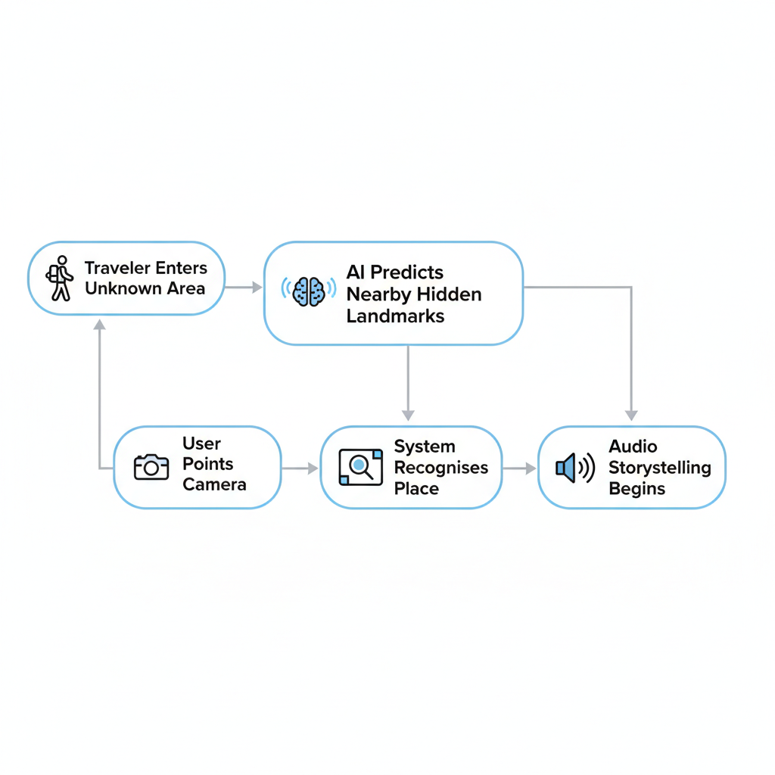
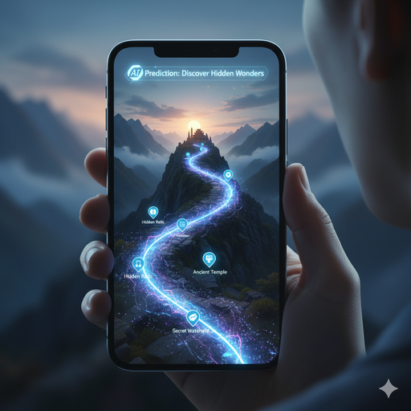
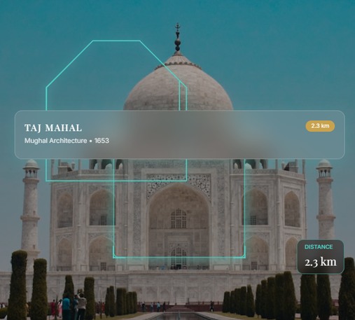

Problem Understanding & Context
To transform exploration from reactive searching into intelligent discovery using Predictive Exploration AI.
Problem:
Explorers frequently encounter culturally and geographically significant locations that remain undocumented or poorly described by existing digital platforms. Current tools react only after a user searches they do not anticipate discovery.
Existing discovery tools are optimized for popular landmarks and internet-heavy environments, leaving remote or lesser-known places underserved
Key Gap:
No predictive intelligence
Limited hyperlocal awareness
Lack of immersive storytelling
High internet dependency

Slide 3


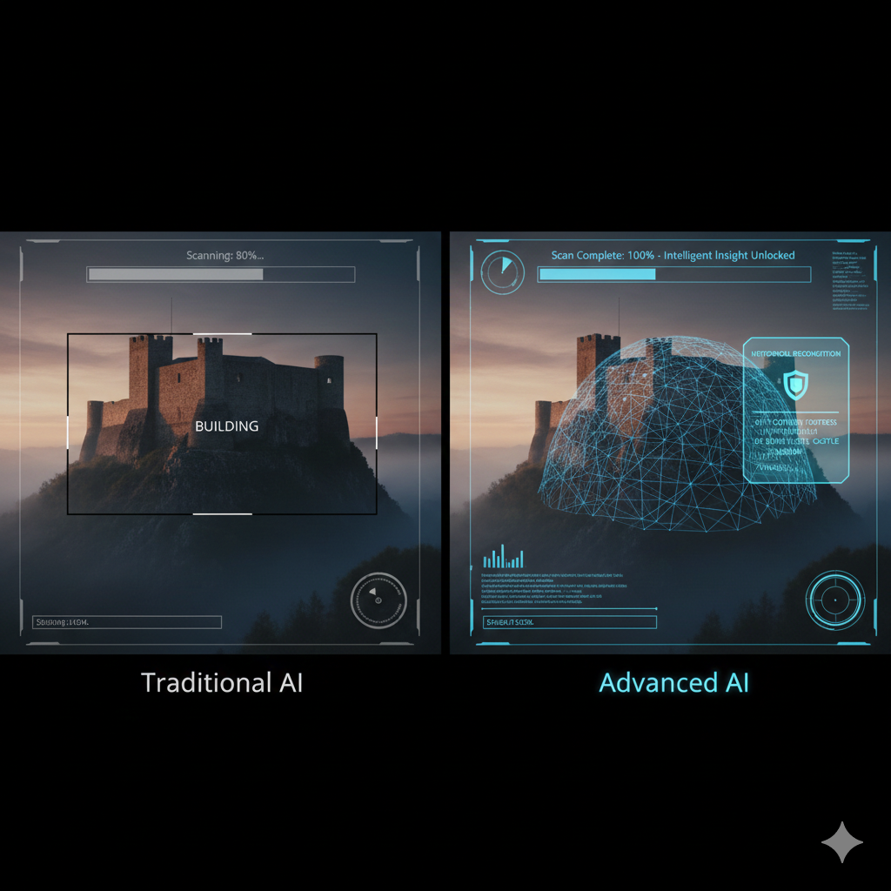

Existing Solutions & Limitations
Today’s AI answers questions. Ours prevents them.
Existing Technologies | Critical Limitations
Visual recognition tools | Reactive rather than predictive
Map-based travel apps | Recognize objects, not significance
AI assistants | Depend heavily on cloud processing
Most current visual AI and travel platforms operate on broad, global datasets designed for scale rather than depth.
They prioritize widely documented landmarks and popular locations, often overlooking rare, undocumented, or culturally nuanced sites.
Their dependence on cloud processing increases latency and reduces usability in remote environments.
Additionally, these systems lack contextual prioritization they identify what is visible but do not assess historical significance proximity relevance, or user intent.
As a result, they provide recognition without meaningful situational intelligence.

Slide 4

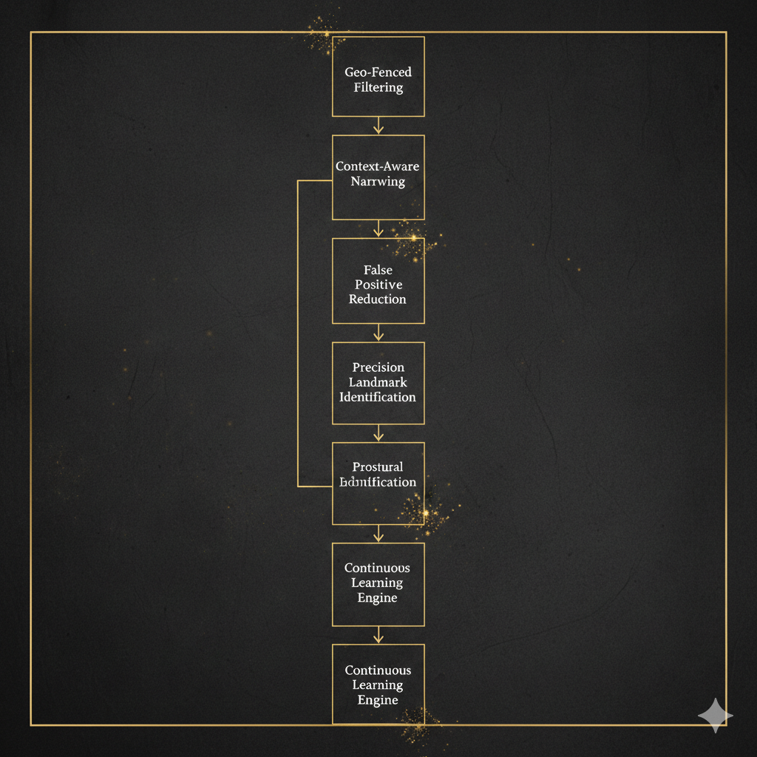



Why Our Approach is Better
We are not building a guide. We are building digital intuition.
Our approach introduces context-driven intelligence by narrowing the search space using geo-fencing before performing visual inference, significantly improving precision and reducing false positives.
By fusing spatial awareness with object detection on-device, the system delivers low-latency, hyperlocal insights even in connectivity-limited environments.
Beyond recognition, it evaluates cultural and contextual relevance, prioritizing information that truly matters to the explorer. This transforms passive identification into an adaptive, scalable discovery engine that evolves with usage.
What Makes Us Different:
Predicts discovery instead of waiting for input
Reconstructs history through Ghost Mode
Adapts narration dynamically
Functions without internet
Creates emotional engagement

Slide 5


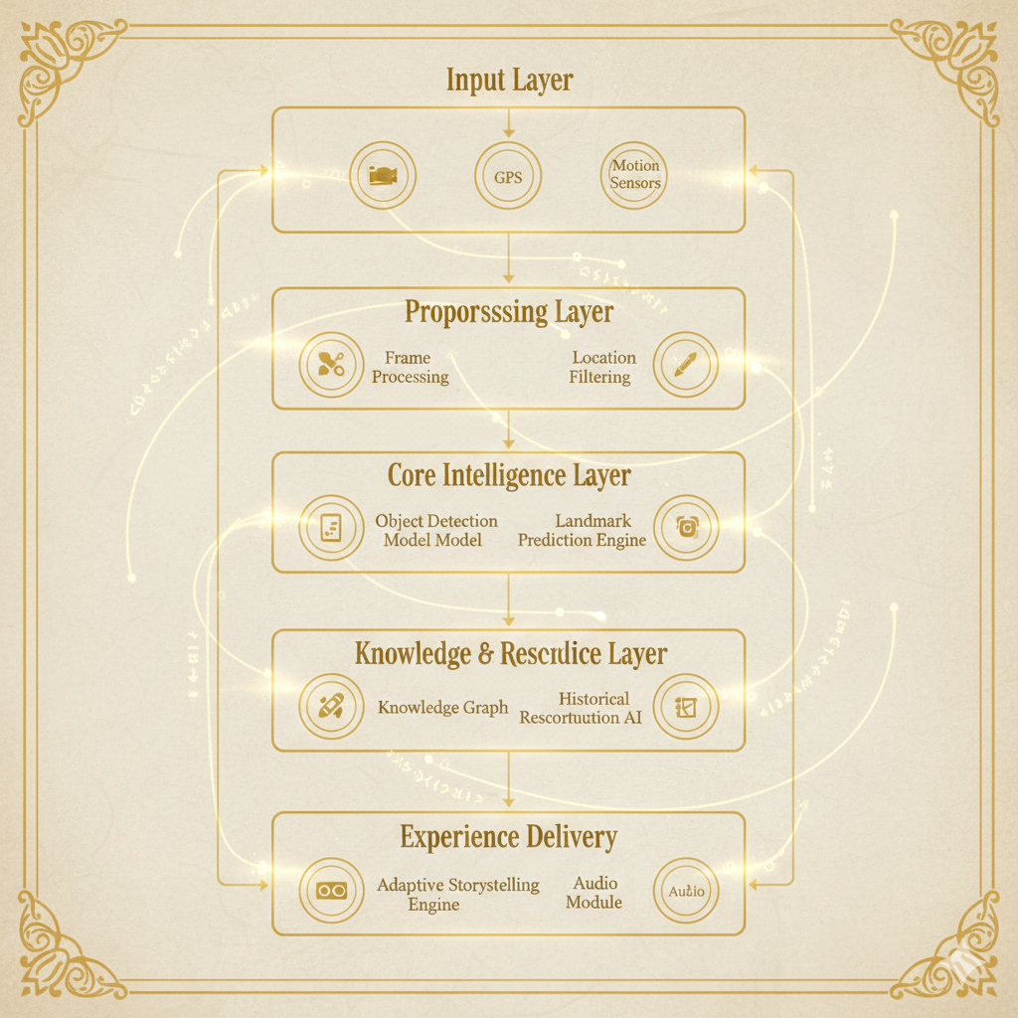
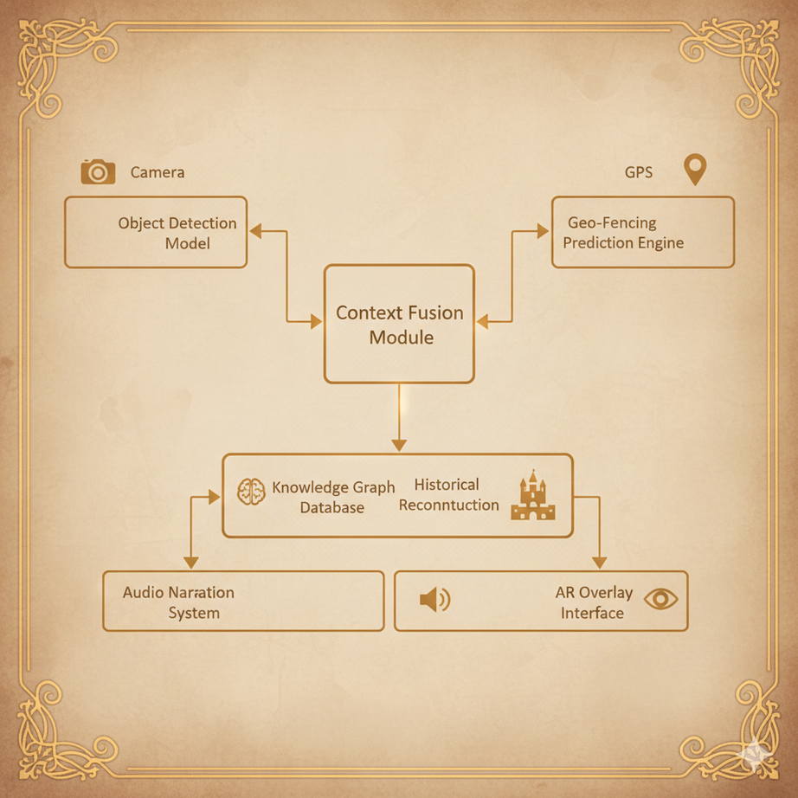
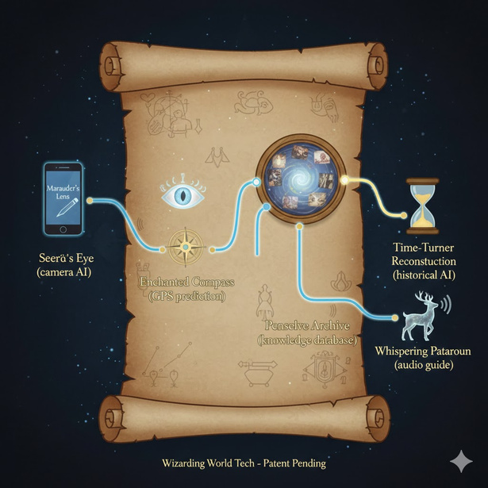

Proposed System Architecture
Our System Introduces Predictive Exploration AI
An offline-first interactive media platform combining:
On-device computer vision
Predictive location intelligence
Hyperlocal cultural graph
Ghost Mode reconstruction engine
Adaptive storytelling AI

Slide 6

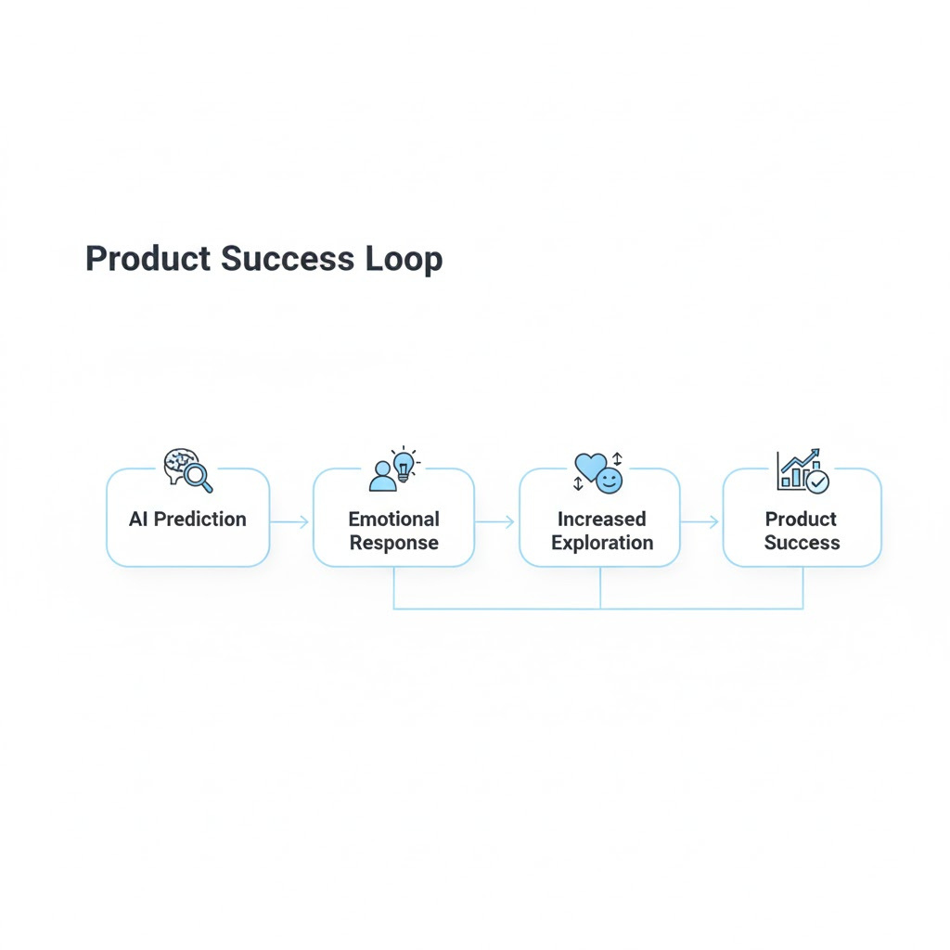
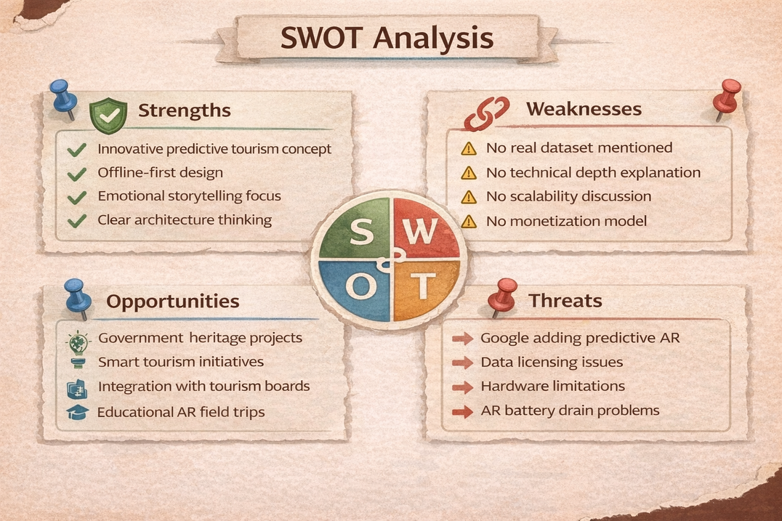
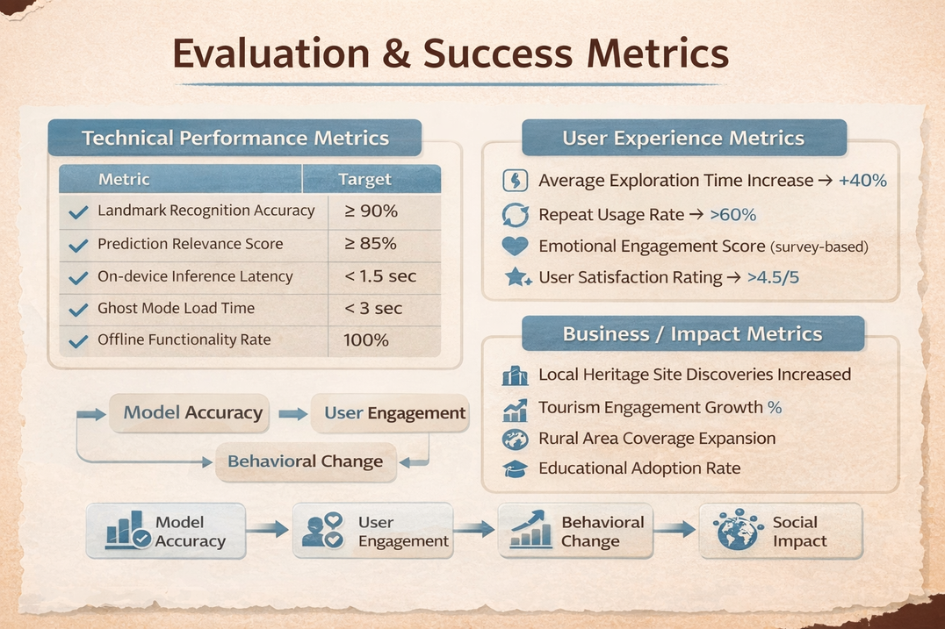
Evaluation & Success Metrics
If users discover places they never planned to — we succeeded
Technical Metrics | Human Metrics
Prediction Accuracy Rate Recognition Latency Offline Performance Stability | Curiosity Trigger Rate Exploration Depth Experience Recall

Slide 7

Thank You!

